Slide 1
How should undergraduate degrees be funded?
Rose Stephenson
Director of Policy and Advocacy
Higher Education Policy Institute

Slide 2
April 2024

Slide 3
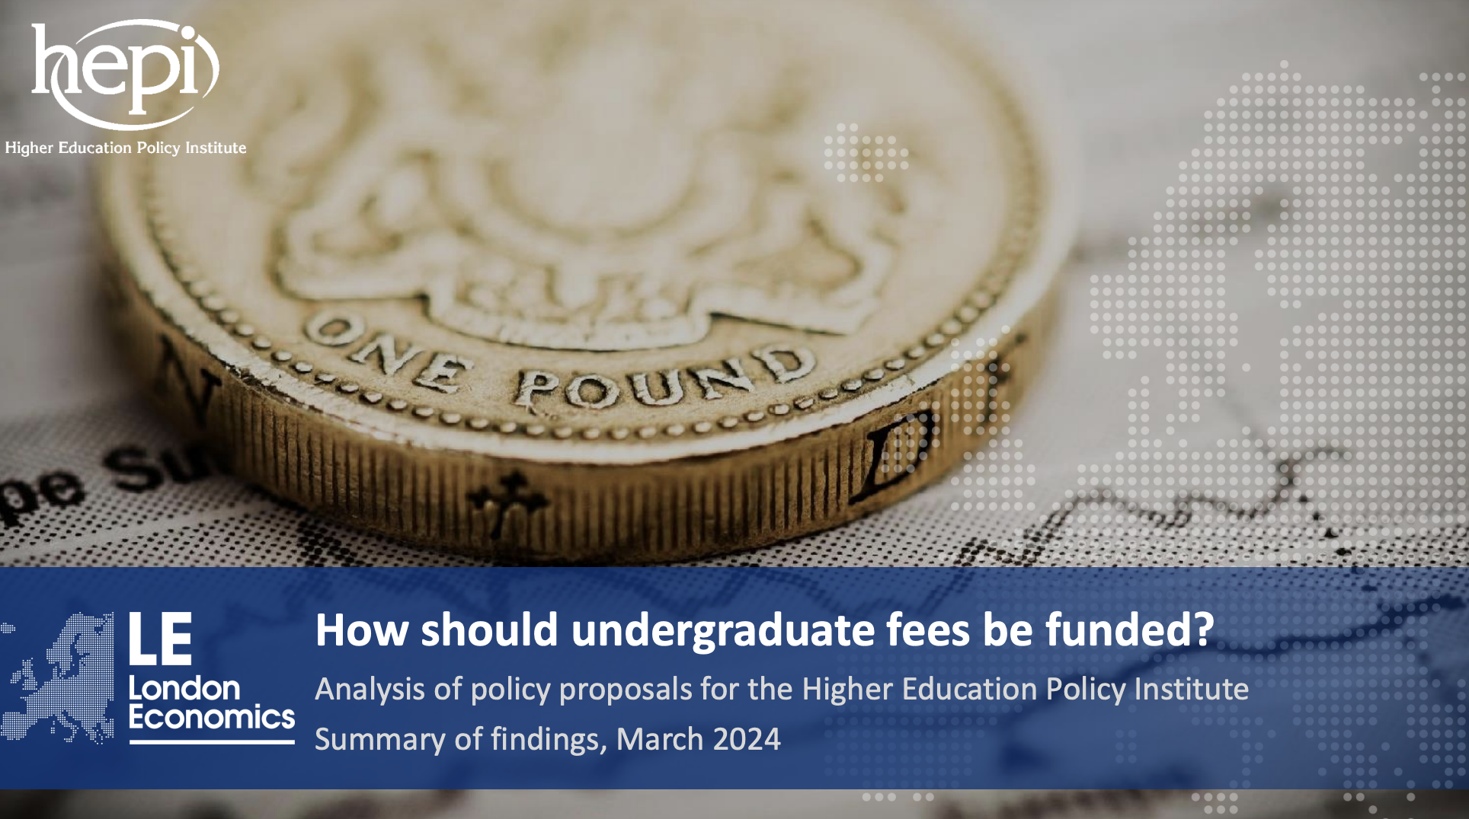
Economic modelling

Slide 4
Attitudes of applicants

Slide 5
Different scenarios - England
The baseline/current funding model for England
Scenario 1 – dismantling the marketisation of higher education – Chloe Field, VP of Education at the NUS
Scenario 2 – Increasing tuition fees linked to an institution’s TEF award - The Right Honourable the Lord Jo Johnson, former Minister of State for Universities and Science (2015), then Minister of State for Universities, Research and Innovation, 2016 to 2018
Scenario 3 – Fixing higher education funding should start with student loans by James Purnell, Former Vice-Chancellor of the University of the Arts, London
Scenario 4 – Modelling a graduate employer levy by Johnny Rich, Chief Executive of the Engineering Professors’ Council and Chief Executive of the outreach organisation, Push

Slide 6
Different scenarios - Scotland
Baseline/current scenario, Scotland
Scenario 5 – A graduate contribution model in Scotland by Reform Scotland

Slide 7
Different scenarios - England
The baseline/current funding model for England
Scenario 1 – dismantling the marketisation of higher education – Chloe Field, VP of Education at the NUS
Scenario 2 – Increasing tuition fees linked to an institution’s TEF award - The Right Honourable the Lord Jo Johnson, former Minister of State for Universities and Science (2015), then Minister of State for Universities, Research and Innovation, 2016 to 2018
Scenario 3 – Fixing higher education funding should start with student loans by James Purnell, President and Vice-Chancellor of the University of the Arts, London
Scenario 4 – Modelling a graduate employer levy by Johnny Rich, Chief Executive of the Engineering Professors’ Council and Chief Executive of the outreach organisation, Push

Slide 8
Different scenarios - Scotland
Baseline/current scenario, Scotland
Scenario 5 – A graduate contribution model in Scotland by Reform Scotland

Slide 9
Baseline scenario in England
Undergraduate tuition fees are £9,250. (2024, full-time students)
Tuition fee and maintenance loans are available.
Teaching grants are in place
Repayment is as follows:
• Repay at a rate of 9% on everything you earn over £25,000 per year.
• The debt will be wiped out after 40 years.

Slide 10
Baseline scenario – income for HEIs
Net income (for UK higher education institutions)
Gross fee income | £11,302m
Teaching grant income | £1,257m
Cost of bursary provision | (£108m)
Total | £12,451m

Slide 11
Baseline scenario – costs the the Exchequer
Net Exchequer cost (adjusted for RAB)
Cost of maintenance loans | (£326m)
Cost of tuition fee loans | (£423m)
Cost of teaching grants | (£1,257m)
Total | (£2,006m)

Slide 12
Baseline scenario – costs to graduates
Average debt on graduation | £50,500
Average lifetime repayments | M £53,800 F £42,100

Slide 13
Baseline scenario – costs
Income for HEIs | £12,451m
Cost to the Exchequer | (£2,006m)
Cost to graduates | (£50,500)

Slide 14
Balance of contribution between the exchequer and graduates
Source: London Economics

Slide 15
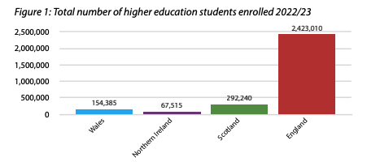
Student population sizes
Source: HESA

Slide 16
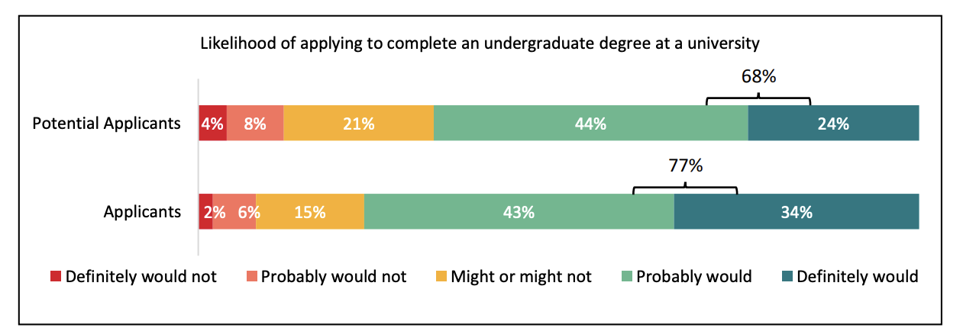
Baseline application rates

Slide 17
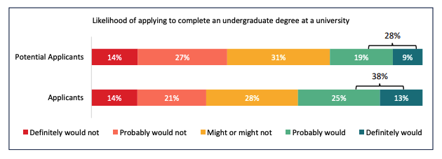
Increasing fees inline with inflation
Baseline = 68% potential applicants, 77% applicants

Slide 18
Dismantling the marketisation
Tuition fees are paid for the by government - – rising with the cost of inflation
Teaching grants remain – rising with the cost of inflation
Reintroduction of maintenance grants for the poorest students
Maintenance loans are available
Real interest rates of
3 per cent during study
0 per cent to 5.5 for postgraduate earnings between £27,571 and £57,570
5.5 per cent thereafter

Slide 19
Dismantling the marketisation
A stepped maintenance loan repayment model:
4 per cent on earnings between £12,570 and £27,570
6 per cent on earnings between £27,571 and £57,570
3 per cent on earnings over £57,571
The repayment threshold will be uprated with average earnings growth.
The debt would be wiped after 31 years.

Slide 20
Costs of dismantling the market
 | Baseline | Dismantling the market
Income for HEIs | £12,451m | £12,893m
Cost to the Exchequer | (£2,006m) | (£12,508m)
Cost to graduates | (£50,500) | (£27,800)

Slide 21
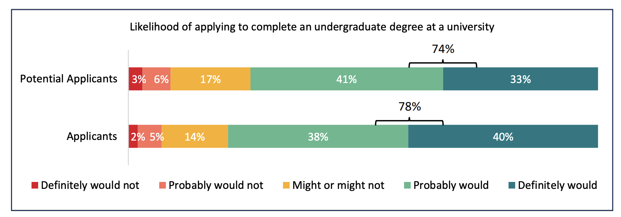
Dismantling the market– application rates
Baseline = 68% potential applicants, 77% applicants

Slide 22
TEF-linked inflationary rises
Universities that gain a Gold or Silver award for the quality of their teaching will be able to increase their tuition fees each year in line with inflation.
Universities that gain a Bronze award for the quality of their teaching will be able to increase their tuition fees each year in line with half the measure of inflation.
Universities that didn’t gain a Gold, Silver, or Bronze award for their teaching quality would not be able to increase their tuition fees, which would remain at £9,250.

Slide 23
Stepped repayment
TEF-linked inflationary rises - costs
 | Baseline | TEF-linked inflationary rises
Income for HEIs | £12,451m | £12,722m
Cost to the Exchequer | (£2,006m) | (£2,064m)
Cost to graduates | (£50,500) | (£51,300)

Slide 24
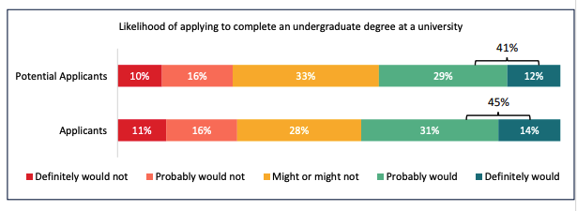
TEF-linked inflationary rises – application rates
Baseline = 68% potential applicants, 77% applicants

Slide 25
TEF-linked inflationary rises – application rates
I would be interested in studying at a top university to guarantee a spot in employment after I graduate.
I would be more likely to apply to a silver or gold standard university even though I don’t agree with that method of ranking.
If a university has a better teaching quality I am more inclined to choose that particular university because the education I will receive will be of a higher standard.

Slide 26
TEF-linked inflationary rises – application rates
I would be less inclined to go to a university that achieved a silver or gold in quality of teaching.
Better universities are more expensive so would be less motivated to aim for a top university.
Less qualified and poor teaching Universities would become more appealing. If I wanted to go for a university with a gold, silver or bronze award, it would cost me more than one that does not.
I would want to apply to a higher end university, but this factor might deter me from doing so.

Slide 27
TEF-linked inflationary rises – application rates
This model is an abomination that reinforces economic inequality, making it so only the wealthiest can attend prestigious universities. I’m not sure how it is even being considered.

Slide 28
A stepped repayment model
Undergraduate tuition fees are £9,250
Tuition fee and maintenance loans are available.
Teaching grants remain in place.
Maintenance grants are available for the poorest students

Slide 29
Baseline repayment

Slide 30
A stepped repayment model

Slide 31
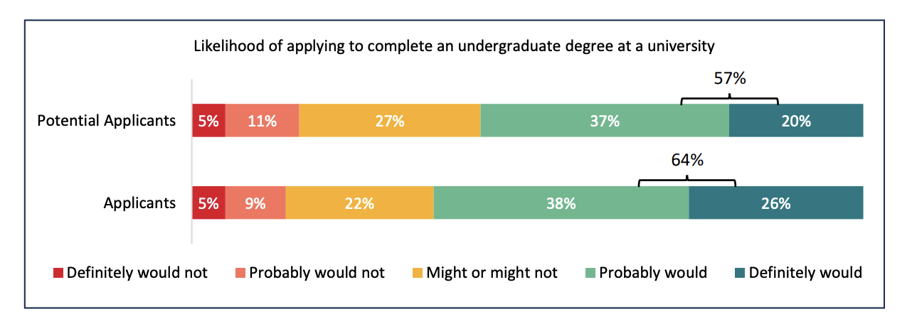
A stepped repayment model – application rates
Baseline = 68% potential applicants, 77% applicants

Slide 32
A stepped repayment model
I want to work hard to become a high-level income worker, but with this model, I might as well not go to university and settle for a low paying job.
You are penalising someone who is able to pay it off early just because others can’t. If they work hard to earn more why should they be locked in to paying loads of interest over many years at a higher rate.

Slide 33
A stepped repayment model
I believe this has been the best model so far. This will make students from lower / middle class families feel more equal to their higher income and more fortunate classmates. I would feel the freedom to apply to any university I wanted [if] I knew I was on equal grounds with others when it comes to repaying loans.

Slide 34
A stepped repayment model – costs
 | Baseline | Stepped repayment
Income for HEIs | £12,451m | £12,452m
Cost to the Exchequer | (£2,006m) | (£1,165m)
Cost to graduates | (£50,500) | (£52,100)

Slide 35
Questions? And keep in touch…
Twitter:
@HEPI_news
@rstephenson123
Email:
admin@hepi.ac.uk
r.stephenson@hepi.ac.uk

